Slide 1

Recommendations regarding a full-time data scientist position
By Ben Niemi
Notes:
Hello, I appreciate the time and attention given to this meeting, I’ll attempt to make it brief as I know that we’re all busy. Today, allow me to present my findings regarding hiring a full-time data scientist position for our company.

Slide 2

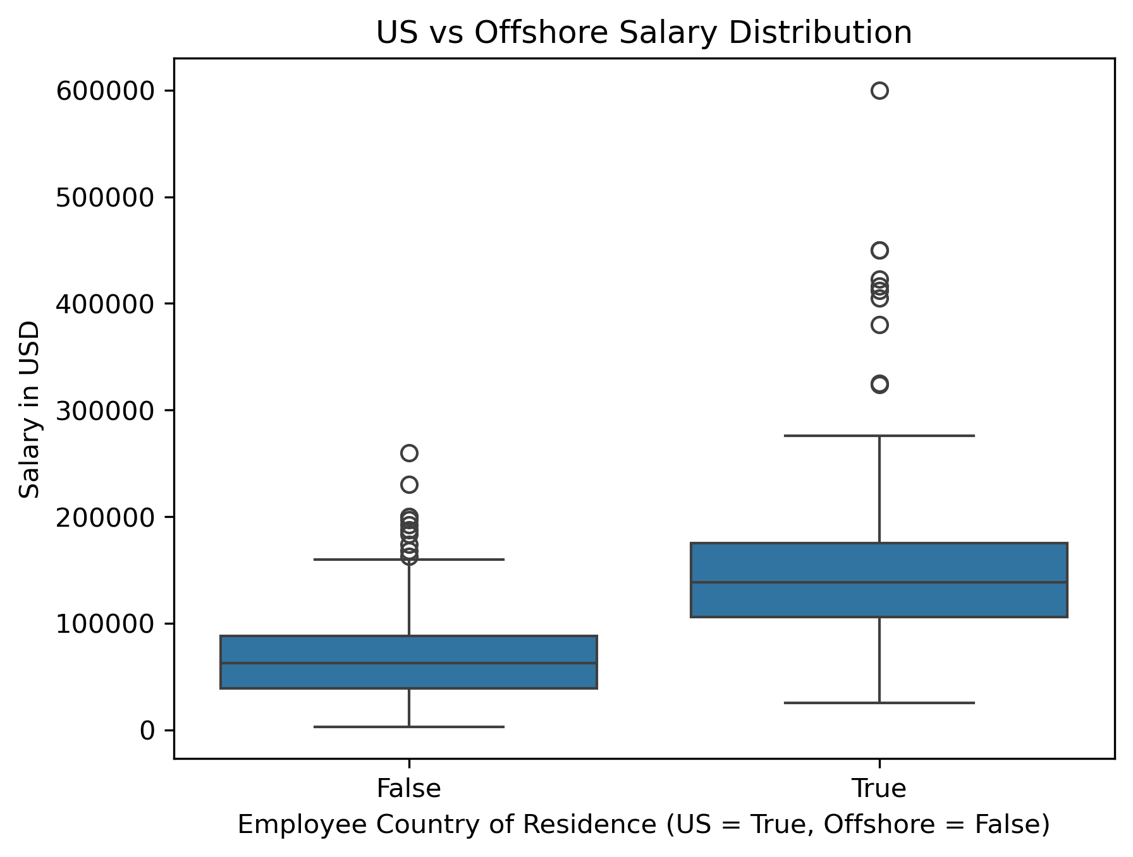
US Vs Offshore comparison
Notes:
The CEO had requested an analysis of working offshore vs in the US.
The bar chart on this slide, based on the data clearly shows that those that work offshore, regardless of experience, are payed less in USD than those who are living in the US. This chart only compares overall salary of US and Offshore employees.
However, a word of caution that comes with these charts: there are pros and cons from hiring someone offshore.
Cost of offshore recruits are typically lower than those of US based applicants.
Management can be an issue either way, the lack of presence in the office can be a detriment if proper support and channels are not set up.
Time Zones can be a benefit or a detriment, on one hand, while the US based team sleeps the offshore team can be on duty, however this can be a delay in decision making and lead to a less-than-optimal meeting schedule.
Knowledge of local practices can be an issue with offshore hires, specifically the knowledge of local processes and behaviors.

Slide 3
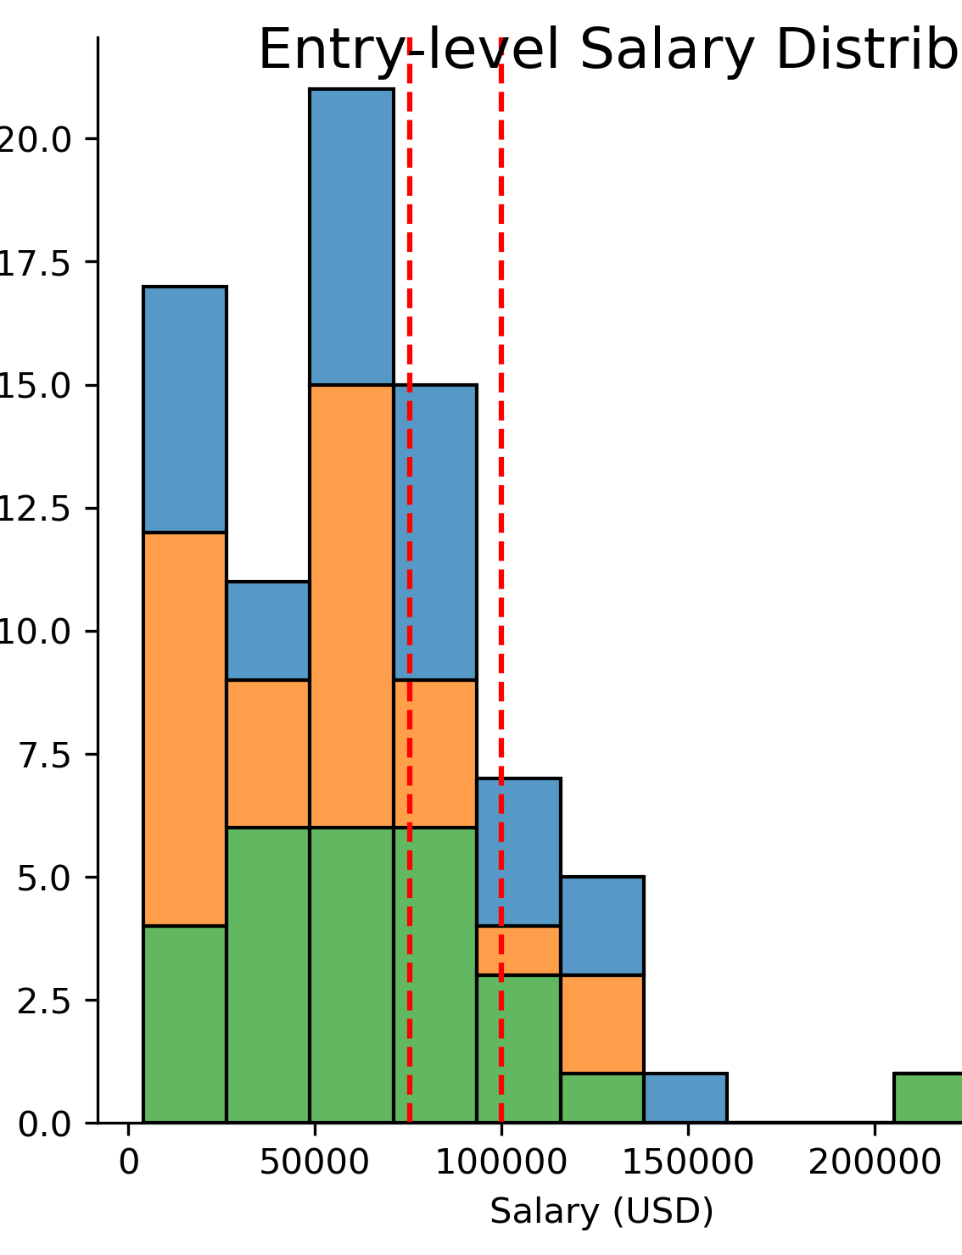
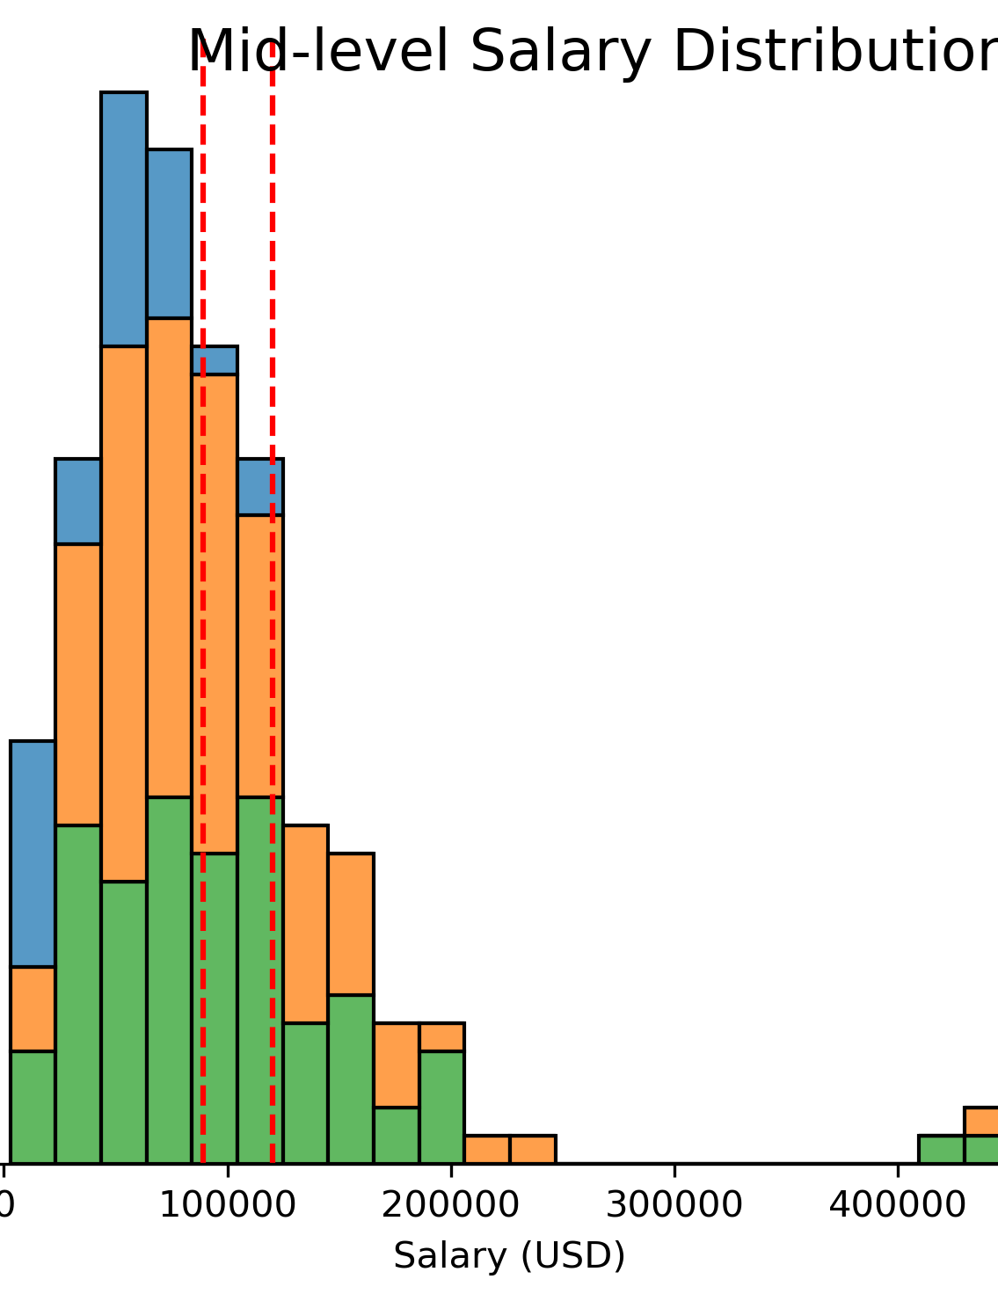
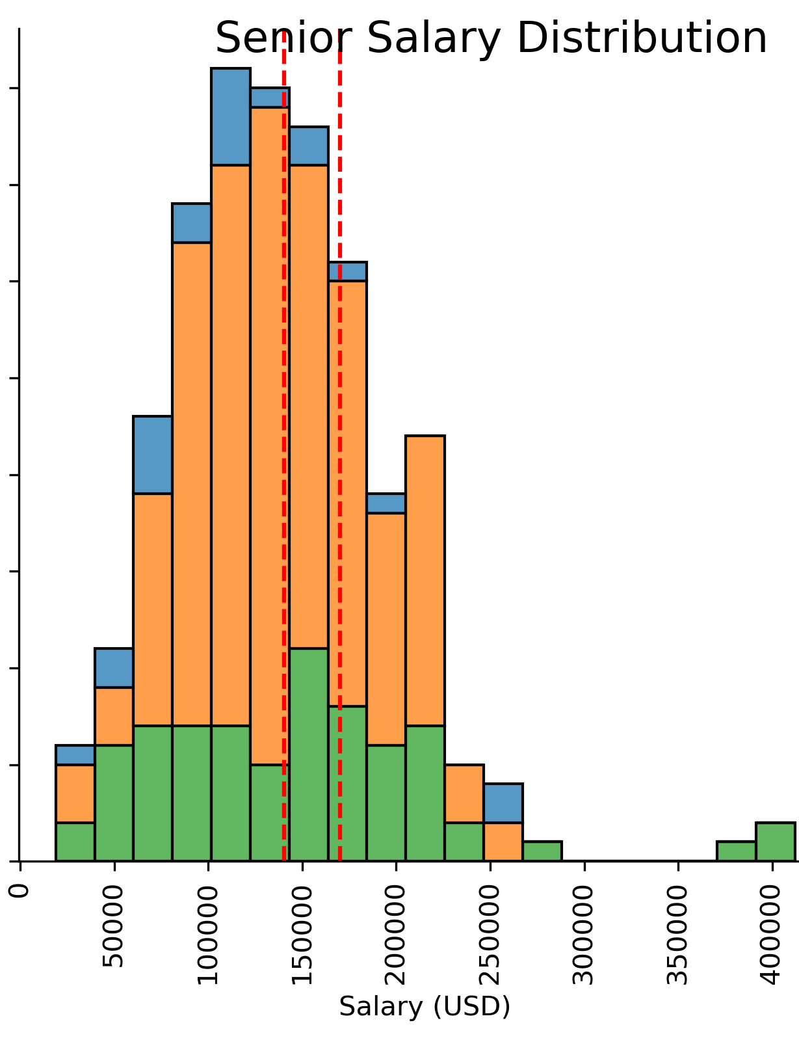
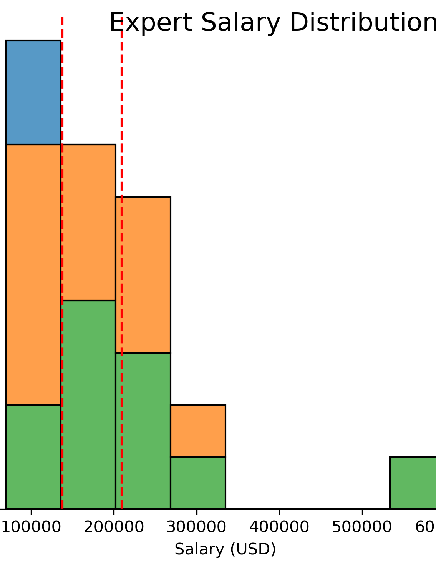
Multi-Level Salary Distribution
Notes:
Here are my overall findings regardless of country:
For reference, Blue is indicative of small companies, Orange is indicative of medium companies, and green is indicative of large companies. (my legend didn’t appear correctly when I exported the images. )
As you can see in the slide, all the distributions are right skewed, and therefore to remain competitive in such a job market, I have arranged red dotted lines to denote ranges that I would recommend for such a position. These considerations were made with fact we are a small company in mind and cannot pay the max for these positions however they all put us in the in higher range for small businesses. For Entry, it’s a range of 65-85 percentile or 75.5k to 100k. For Mid-level it’s a 60-80 percentile or 89.3k to 120k. For senior it’s 55-75 percentile. Or 140.2k to 170k Lastly for expert it’s 138k to 209.6k.

Slide 4


Final Recommendation
Key Qualifications of the first Data Scientist:
  Affordable for the company
  Leadership potential
  Organizational and procedural knowledge
Final Recommendation:
A Mid-level or Senior Level experienced employee
  Affordable
  Knowledgable
  Leadership Capable
Thank you for your time
And Attention.
Notes:
As you can see on the slide, I’ve outlined the key qualifications for the new data scientist in my opinion.
Firstly, that they be affordable for the company. As we are a small, but rapidly growing company, the bottom line must be considered.
Secondly, that they are capable leadership material in the role, as the current plan is that this individual will build the data science section and then expand personnel on that premise.
Thirdly, that they are adaptable and capable in their organizational(company), and procedural(coding/analysis) knowledge.
My recommendation for mid-level to senior level experience is predicated on these individuals being knowledgeable about procedures, or adaptable to them. They would have leadership ability and would be most affordable for the company.
Entry level, while affordable would not have the leadership or possibly the knowledge to build out the data science section.
Expert level, while having the requisite knowledge and experience would more than likely be outside of the company’s budget and therefore not possible for hiring.

